Slide 1



Secure Solution GNX E600 Pure
Lyubomir Georgiev, Hristo Kolev, Yoan-Asen Popov, Joep Vinken
Notes:
Lyubo

Slide 2

Table of contents
01
02
03
04
05
Overview of the project
Enable Secure Boot
Cryptographic Keys
Project Scope and Objectives
Enable Secure Boot in the Firmware
Generating and Safeguarding the Keys
06
07
Plan B
Conclusion
Signing Components
Process Validation
Signing the Firmware Components
Boot Process Validation
Backup Measures for Secure Boot
Final Observations and Conclusion
Notes:
Lyubo

Slide 3
01
Project Overview
Project Scope and Objectives
Notes:
Lyubo

Slide 4

Project Overview
Follow-up on pen-test
Create a advisory report on secure boot
Our focus: The Genexis E600 Pure router
Important upgrade for the found weaknesses
Notes:
Explain our goal to create the advisory report on secure boot
Implementation not possible due to time restrictions
Explain what secure boot is ensure the execution of only trusted and verified firmware components during the boot process.
Research question:
How to implement secure boot on the GNC Pure E600 network router?
Lyubo

Slide 5
02
Enable Secure Boot
Enable Secure Boot in the Firmware
You can enter a subtitle here if you need it
Notes:
Yoan

Slide 6
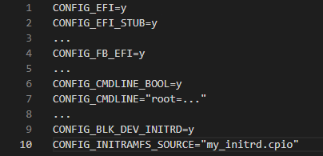
Enable Secure Boot
Enable EFI Mode
Configure Kernel Command Line
Installing the Kernel
Testing the Kernel Image
Notes:
Kernel Configuration Options for EFI Mode:
Enable EFI mode to build the kernel as an EFI binary
No need for a separate bootloader; UEFI bios directly boots the kernel
Kernel Configuration Parameters:
CONFIG_CMDLINE: Set the command line for the kernel
Specify root partition and init to be used
Building and Installing the Kernel:
Set CONFIG_INITRAMFS_SOURCE for an initramfs image
Build and install the kernel on the boot partition
Place the kernel at /boot/EFI/boot/bootx64.efi for UEFI booting
Testing the Kernel Image:
Access BIOS settings and locate UEFI boot mode
Disable "Secure Boot" option in BIOS settings
Save the changes and reboot to automatically boot the kernel
Secure Boot and Kernel Signing:
After successful boot in insecure mode, create secure boot keys
Sign the kernel with the secure boot keys for enhanced security
Yoan

Slide 7
03
Cryptographic Keys
Generating and Safeguarding Cryptographic keys
You can enter a subtitle here if you need it
Notes:
Hristo

Slide 8
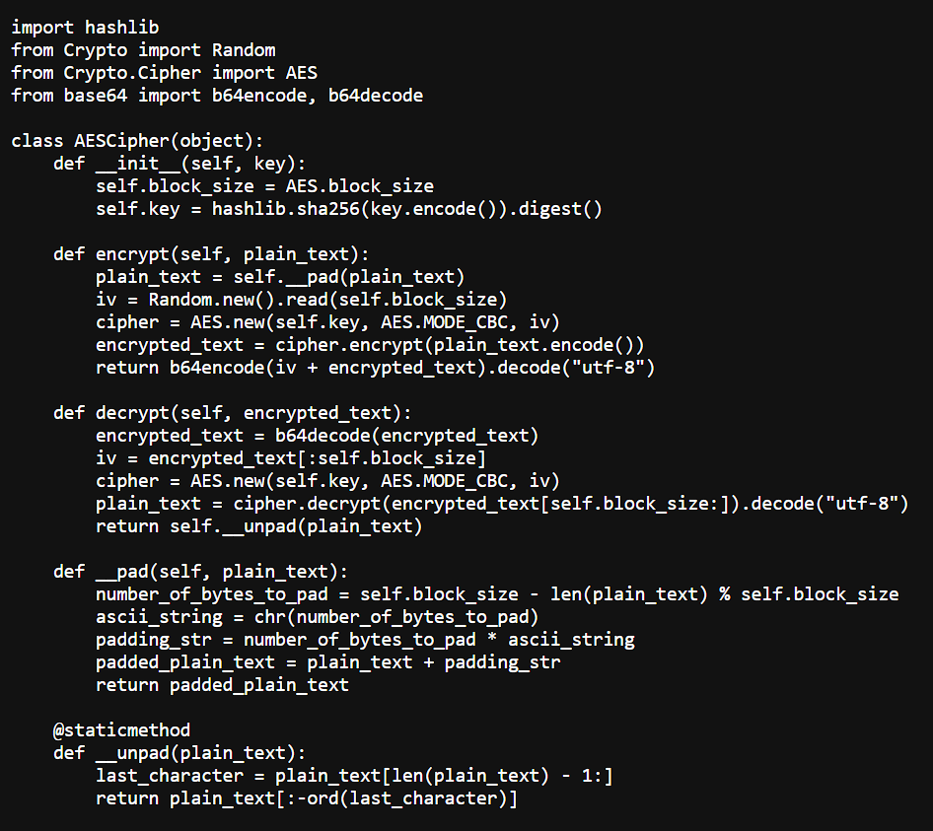
Cryptographic Keys
Encryption types
Symmetric Key Encryption
Asymmetric Key Encryption
One secret key
AES for bootloader communications and data encryption
Public and private key
RSA & ECC for bootloader communications and data encryption
Notes:
AES (Advanced Encryption Standard) -> Widely used secure symmetric encryption key which is generated and shared among authorized entities.
RSA (Rivest Shamir-Adleman) -> widely used asymmetric ecryption algorythm. Perfect for secure boot
ECC (Elliptic Curve Cryptogrpahy) -> Alternative to RSA. Strong security with shorter keys, therefore more efficient for resource-constrained devices (routers). Secp256r1 or secp384r1 ideal for bootloader security
HSM (Hardware Security Modules) -> dedicated hardware devices designed to securely manage and store keys. Dstrong physical and logical protection against theft or unauthorized access.
TPM (Trusted Platform Module) -> chip which canbe leveraged into storing keys securely (smart cards, USB tokens,...) more on that later (slide 11)
Hristo

Slide 9
04
Signing Components
Signing Firmware Components
You can enter a subtitle here if you need it
Notes:
Joep

Slide 10
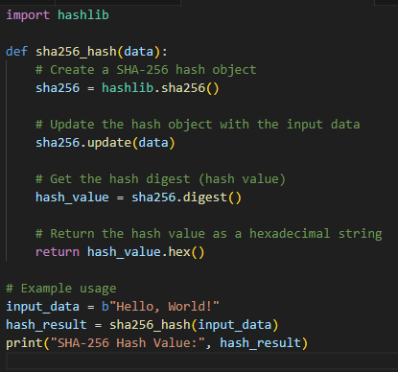
Signing Components
Bootloader can have multiple purposes
Bootloader should be securely signed & verified
SHA hashing and SHA-256
Kernel signing
Notes:
In summary, bootloader is a program or set of instructions that runs when a computer or device is powered on or restarted. It is responsible for initializing the system and loading the operating system (OS) into the computer's memory.
Securely signing and verifying prevents unauthorized modifications and protects against malicious code execution
SHA (Secure Hash Algorithm) -> a family of cryptographic hash functions that generate a fixed-size output
SHA-256 strong cryptographic properties and wide support -> used for data integrity, password storage, digital signatures and secure boot
Picture: Exmaple SHA-256 hash in python. Takes input data, performs sha-256 hashing using hashlib. Return hexadecimal String. Result can be used for security applications
Kernel signing: process of digitally signing the kernel or kernel modules in an operating system to ensure their integrity and authenticity
Verifies identity of kernel or modules before loading into memory
Joep

Slide 11
05
Process Validation
Boot Process Validation
You can enter a subtitle here if you need it
Notes:
Lyubo

Slide 12
Process Validation
Digital Signature Validation: At the heart of the boot process is the rigorous inspection of digital signatures of key elements like the bootloader and kernel, carried out by Secure Boot. This inspection involves a detailed comparison with the public key of the signature, maintaining the purity of the components, and effectively protecting against the operation of unauthenticated or harmful code.
Trusted Platform Module (TPM): TPM serves as a security fortress, a hardware component purposely built for secure storage of cryptographic keys, generation of random numbers in a secure manner, and sturdy cryptographic operations. By validating the execution of authorized software and firmware during the boot process, TPM ensures system integrity.
Integrity Verification: A vital element of boot process validation is the integrity check of signed components. By computing and juxtaposing cryptographic hashes of the components, it confirms that the components remain untouched after signing, offering an added layer of security.
Notes:
Digital Signature Validation:
Core role: Emphasize digital signature validation in boot process.
Secure Boot: Scrutinizes digital signatures of pivotal components.
Comparison: Compares signatures with public key for component sanctity.
Protection: Robust shield against unauthorized or malicious code execution.
Detailed Exploration:
Reliance on asymmetric encryption: Explain the use of digital signatures.
Integrity and authenticity: Signatures are compared with public key.
Trusted execution: Allows only trusted components to be executed.
Trusted Platform Module (TPM):
Dedicated security layer: Highlight the role of TPM.
Primary functions: Secure storage of cryptographic keys, secure random number generation, and strong cryptographic operations.
Enhanced system integrity: Ensures execution of authorized software and firmware.
Example Code:
Practical application: Share C language code snippet using TSS library.
Activating secure boot via TPM: Illustrate the process.
Integrity Verification:
Critical function: Explain integrity verification in boot process.
Post-signing immutability: Calculation and comparison of cryptographic hashes.
Extra layer of security: Highlight its significance.
Diverse Validation Mechanisms & Their Impact:
Variation in validation mechanisms: Discuss differences in router firmware.
Cryptographic algorithms, key management, and validation procedures: Explain impact of variations.
Importance of understanding firmware specifications and manufacturer guidelines: Ensure solid boot process validation and reduce unauthorized code execution.
Invitation to Action:
Conclude by inviting audience to explore accompanying document.
Comprehensive understanding: Mention example code and additional technical details.
Lyubo

Slide 13
06
Plan B
Backup Measures for Secure Boot
Notes:
Joep

Slide 14
Plan B
Corrupt Bootloader Image
Invalid or Expired signature
Causes: compromised signature, expired signature or failing to update or renew certificates
Solution: Check validity and expiration date of signature during boot
Causes: updated software, malware or malicious actors, environmental factors
Solution: Failsafe option to fall back to know good bootloader
Incompatible or tempered kernel image
Rollback Attack
Causes: Fail to detect of prevent unauthorized downgrades, weaknesses in update process, inadequate validation of signature during update
Solution: Secure firmware update mechanism to ensure authorized firmware updates
Causes: incompatible changes after update, malicious actors, lack of rigorous (pen-)testing.
Solution: Verify integrity and compatibility of kernel image before loading
Notes:
Corrupt bootloader: failsafe in separate location. Can be implemented by adding redundant copy of image in backup partition
Invalid or expired digital signature: if invalid > provide option to boot with limited functionality mode or prompt user to update firmware
Incompatible or tempered kernel image: if image is not compatible or tampered with > switch to known good kernel image or prompt user to update firmware
Rollback attack: first issue allows attackers to exploit vulnerabilities in older versions. Second issue allows MITM attacks or intercepted update packages
Third issue allows hacker to forge or bypass signature checks, facilitating rollback attack
Solution: enforcing digital signature checks on firmware updates and storing a secure version history to prevent rollback attacks.
Joep

Slide 15
07
Conclusion
Final observations and Conclusion
Notes:
Yoan

Slide 16
Conclusion
Implementation of Secure Boot on Linux-based Wi-Fi routers is crucial for robust security.
Secure Boot enhances security and mitigates unauthorized access
Report provides detailed technical insights and example
Notes:
Yoan

Slide 17
Thank you
Do you have any questions?
Notes:
Hristo

